Slide 1

Module 5: Resolving Host Names by Using Domain Name System (DNS)

Slide 2

Overview
Multimedia: The Role of DNS in the Network Infrastructure
Installing the DNS Server Service
Configuring the Properties for the DNS Server Service
Configuring DNS Zones
Configuring DNS Zone Transfers
Configuring DNS Dynamic Updates
Configuring a DNS Client
Delegating Authority for Zones

Slide 3


Multimedia: The Role of DNS in the Network Infrastructure
The objective of this presentation is to provide a high-level overview of DNS in the network infrastructure
At the end of this presentation, you will be able to:
  Explain the role and benefits of DNS in the network infrastructure
  Define the key components of DNS
  Discuss the DNS domain namespace
  Discuss DNS zones and zone transfer
  Discuss DNS name servers
  Explain how the hosts name resolution process works
  Explain forward lookup queries

Slide 4
Lesson: Installing the DNS Server Service
Overview of Domain Name System
What Is a Domain Namespace?
Standards for DNS Naming
How to Install the DNS Server Service

Slide 5
Overview of Domain Name System
Domain Name System (DNS) is a hierarchical, distributed database that contains mappings of DNS domain names to various types of data, such as IP addresses
DNS is the foundation of the Internet naming scheme and the foundation of an organization’s naming scheme
DNS supports accessing resources by using alphanumeric names
InterNIC is responsible for delegating administrative responsibility for portions of the domain namespace and for registering domain names
DNS was designed to solve issues that arose when there was an increase in the:
  Number of hosts on the Internet
  Traffic generated by the update process
  Size of the Hosts file

Slide 6

What Is a Domain Namespace?
Root Domain
net
com
org
Top-Level Domain
nwtraders
Second-Level Domain
west
south
east
Subdomains
sales
FQDN:
server1.sales.south.nwtraders.com
Host: server1

Slide 7
Standards for DNS Naming
The following characters are valid for DNS names:
A-Z
a-z
0-9
Hyphen (-)
The underscore (_) is a reserved character

Slide 8
How to Install the DNS Server Service
Your instructor will demonstrate how to install the DNS Server service

Slide 9

Practice: Installing the DNS Server Service
In this practice, you will install the DNS Server service

Slide 10
Lesson: Configuring the Properties for the DNS Server Service
What Are the Components of a DNS Solution?
What Is a DNS Query?
How Recursive Queries Work
How a Root Hint Works
How Iterative Queries Work
How Forwarders Work
How DNS Server Caching Works
How to Configure the Properties for the DNS Server Service

Slide 11
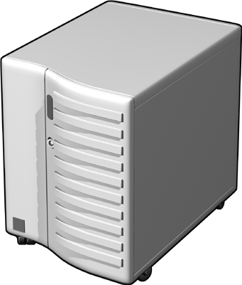





What Are the Components of a DNS Solution?
DNS Clients
DNS Servers
DNS Servers on the Internet
Root “.”
Resource
Record
.com
.edu
Resource
Record

Slide 12
What Is a DNS Query?
A query is a request for name resolution to a DNS server. There are two types of queries: recursive and iterative
DNS clients and DNS servers both initiate queries for name resolution
An authoritative DNS server for the namespace of the query will either:
  Check the cache, check the zone, and return the requested IP address
  Return an authoritative, “No”
A non-authoritative DNS server for the namespace of the query will either:
  Forward the unresolvable query to a specific query server called a Forwarder
  Use root hints to locate an answer for the query

Slide 13

How Recursive Queries Work
A recursive query is a query made to a DNS server, in which the DNS client asks the DNS server to provide a complete answer to the query
DNS server checks the forward lookup zone and cache for an answer to the query
Recursive query for
mail1.nwtraders.com
172.16.64.11
Database
Computer1
Local DNS Server

Slide 14

How Root Hint Works
Root hints are DNS resource records stored on a DNS server that list the IP addresses for the DNS root servers
Cluster of
DNS Servers
Cluster of
Root (.) Servers
Root Hints
com
DNS Server
microsoft
Computer1

Slide 15
How Iterative Queries Work
An iterative query is a query made to a DNS server in which the DNS client requests the best answer that the DNS server can provide without seeking further help from other DNS servers. The result of an iterative query is often a referral to another DNS server lower in the DNS tree
Iterative Query
Local
DNS Server
Ask .com
1
Root Hint (.)
Iterative Query
Ask nwtraders.com
.com
Recursive query for
mail1.nwtraders.com
2
172.16.64.11
Iterative Query
Authoritative Response
3
Computer1
nwtraders.com

Slide 16
How Forwarders Work
A forwarder is a DNS server designated by other internal DNS servers to forward queries for resolving external or offsite DNS domain names
Iterative Query
Forwarder
Root Hint (.)
Ask .com
Iterative Query
Ask nwtraders.com
.com
Recursive Query
172.16.64.11
Iterative Query
172.16.64.11
Authoritative Response
Recursive query for
mail1.nwtraders.com
nwtraders.com
Local
DNS Server
Computer1

Slide 17
How DNS Server Caching Works
Caching Table
Host Name | IP Address | TTL
clientA.contoso.msft. | 192.168.8.44 | 28 seconds
Where’s Client A?
ClientA is at 192.168.8.44
ClientA
Client1
ClientA is at 192.168.8.44
Where’s Client A?
Client2
Caching is the process of temporarily storing recently accessed information in a special memory subsystem for quicker access

Slide 18

How to Configure Properties for the DNS Server Service
Your instructor will demonstrate how to:
Update root hints on a DNS server
Configure a DNS server to use a forwarder
Clear the DNS server cache by using the DNS console
Clear the DNS server cache by using the DNSCmd command

Slide 19
Practice: Configuring Properties for the DNS Server Service
In this practice, you will configure the properties for the DNS Server service

Slide 20
Lesson: Configuring DNS Zones
How DNS Data Is Stored and Maintained
What Are Resource Records and Record Types?
What Is a DNS Zone?
What Are DNS Zone Types?
How to Change a DNS Zone Type
What Are Forward and Reverse Lookup Zones?
How to Configure Forward and Reverse Lookup Zones

Slide 21
How DNS Data Is Stored and Maintained
Namespace: training.nwtraders.msft
DNS Server
Resource records for the zone training.nwtraders.msft
Host name | IP address
DNS ClientA | 192.168.2.45
DNS ClientB | 192.168.2.46
DNS ClientC | 192.168.2.47
Zone File:
Training.nwtraders.msft.dns
DNS ClientC
DNS ClientA
DNS ClientB
A resource record (RR) is a standard DNS database structure containing information used to process DNS queries
A zone is a portion of the DNS database that contains the resource records with the owner names that belong to the contiguous portion of the DNS namespace

Slide 22
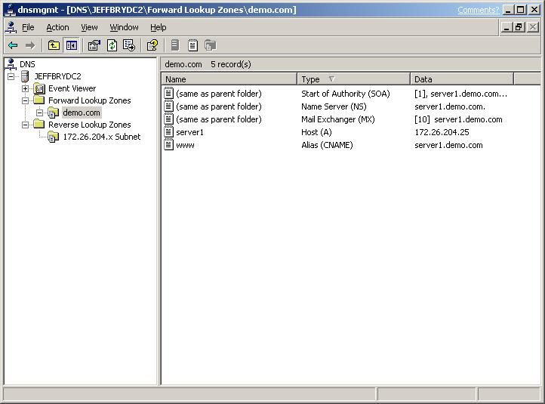
What Are Resource Records and Record Types?
Record type | Description
A | Resolves a host name to an IP address
PTR | Resolves an IP address to a host name
SOA | The first record in any zone file
SRV | Resolves names of servers providing services
NS | Identifies the DNS server for each zone
MX | The mail server
CNAME | Resolves from a host name to a host name

Slide 23
What Is a DNS Zone?
Nwtraders
South
West
North
Sales
Support
Training

Slide 24
What Are DNS Zone Types?
Zones | Description
Primary | Read/write copy of a DNS database
Secondary | Read-only copy of a DNS database
Stub | Copy of a zone containing limited records
Read/Write
Read-Only
Copy of
limited
records

Slide 25
How to Change a DNS Zone Type
Your instructor will demonstrate how to change a DNS zone type

Slide 26
What Are Forward and Reverse Lookup Zones?
Namespace: training.nwtraders.msft.
Forward zone | Training | DNS Client1 | 192.168.2.45
 |  | DNS Client2 | 192.168.2.46
 |  | DNS Client3 | 192.168.2.47
Reverse zone | 1.168.192.in-addr.arpa | 192.168.2.45 | DNS Client1
 |  | 192.168.2.46 | DNS Client2
 |  | 192.168.2.47 | DNS Client3
DNS Server Authorized
for training
DNS Client2 = ?
192.168.2.46 = ?
DNS Client3
DNS Client1
DNS Client2

Slide 27
How to Configure Forward and Reverse Lookup Zones
Your instructor will demonstrate how to:
Configure a forward lookup zone on a primary zone type
Configure a forward lookup stub zone
Configure a forward lookup zone on a secondary zone type
Configure a reverse lookup zone on a primary zone type
Configure a reverse lookup zone on a secondary zone type

Slide 28
Practice: Configuring a DNS Zone
In this practice, you will the configure DNS zones

Slide 29
Lesson: Configuring DNS Zone Transfers
How DNS Zone Transfers Work
How DNS Notify Works
How to Configure DNS Zone Transfers

Slide 30
How DNS Zone Transfers Work
A DNS zone transfer is the synchronization of authoritative DNS zone data between DNS servers
1
SOA query for a zone
2
SOA query answered
3
IXFR or AXFR query for a zone
4
IXFR or AXFR query answered
(zone transfer)
Secondary Server
Primary and
Master Server

Slide 31
How DNS Notify Works
A DNS notify is an update to the original DNS protocol specification that permits notification to secondary servers when zone changes occur
Resource record is updated
1
Destination Server
Source Server
2
SOA serial number is updated
3
DNS notify
4
Zone transfer
Secondary Server
Primary and
Master Server

Slide 32
How to Configure DNS Zone Transfers
Your instructor will demonstrate how to configure a DNS zone transfer and DNS notify

Slide 33
Practice: Configuring DNS Zone Transfers
In this practice, you will configure DNS zone transfers

Slide 34
Lesson: Configuring DNS Dynamic Updates
Multimedia: Overview of DNS Dynamic Updates
What Are Dynamic Updates?
How DNS Clients Register and Update Their Own Resource Records by Using Dynamic Updates
How a DHCP Server Registers and Updates Resource Records by Using Dynamic Updates
How to Configure DNS Manual and Dynamic Updates
What Is an Active Directory-Integrated DNS Zone?
How Active Directory-Integrated DNS Zones Use Secure Dynamic Updates
How to Configure Active Directory-Integrated DNS Zones to Allow Secure Dynamic Updates

Slide 35

Multimedia: Overview of DNS Dynamic Updates
The objective of this presentation is provide a high-level overview of DNS dynamic updates
At the end of this presentation, you will be able to:
  Explain why DNS dynamic updates are important
  Explain the difference between manual and dynamic updates
  Explain that client computers can either dynamically update resource records in DNS themselves or have DHCP perform dynamic updates in DNS on their behalf
  Explain what secure dynamic updates
  are

Slide 36
What Are Dynamic Updates?
A dynamic update is the process of a DNS client dynamically creating, registering, or updating its records in zones that are maintained by DNS servers that can accept and process messages for dynamic updates
A manual update is the process of an administrator manually creating, registering, or updating the resource record
Dynamic update enables DNS client computers to interact automatically with the DNS server to register and update their own resource records
  Organizations that have dynamic changes can benefit from the dynamic method of updating DNS resource records
Organizations may benefit from manual update if they:
  Are in a smaller environment that has few changes to their resource records
  Have isolated instances, such as when a larger organization chooses to control every address on every host.

Slide 37

How DNS Clients Register and Update Their Own Resource Records by Using Dynamic Updates
DNS Server
Resource
Records
1
Client sends SOA query
DNS server sends zone name and server IP address
2
1
2
3
4
5
3
Client verifies existing registration
DNS server responds by stating that registration does not exist
4
5
Client sends dynamic update to DNS server
Windows
Server 2003
Windows
XP
Windows
2000

Slide 38
How a DHCP Server Registers and Updates Resource Records by Using Dynamic Updates
DNS Server
DHCP client makes an IP lease request
1
Resource
Records
2
DHCP server grants IP lease
3
DHCP server automatically generates client’s FQDN
3
4
4
Using dynamic update, the DHCP server updates the DNS forward and reverse records for the client
1
2
Window Server 2003
Running DHCP
IP Address Lease
DHCP Down-
level Client

Slide 39
How to Configure DNS Manual and Dynamic Updates
Your instructor will demonstrate how to:
Configure a DNS server running Windows Server 2003 to accept dynamic updates of DNS resource records
Configure a Windows XP Professional client to dynamically update its DNS resource records in DNS
Configure a DHCP server running Windows Server 2003 to dynamically update DNS resource records in DNS on behalf of DHCP clients
Manually create a DNS resource record

Slide 40
What Is an Active Directory-Integrated DNS Zone?
DNS zone type | Benefit
Non Active Directory-integrated zone | Does not require Active Directory
Active Directory-integrated zone | Stores DNS zone data in Active Directory and is thus more secure Uses Active Directory replication instead of zone transfers Allows only secure dynamic updates Uses multi-master instead of single master structure
An Active Directory-integrated DNS zone is a DNS zone stored in Active Directory

Slide 41

How Active Directory-Integrated DNS Zones Use Secure Dynamic Updates
A secure dynamic update is a process in which a client submits a dynamic update request to a DNS server, and the server attempts the update only if the client can prove its identity and has the proper credentials to make the update
Find authoritative server
DNS Client
running
Windows XP
Result
Local
DNS Server
Find authoritative server
Result
Attempt non-secure update
Refused
Secure update negotiation
Accepted
Domain Controller with
Active Directory-
Integrated DNS Zone

Slide 42
How to Configure Active Directory-Integrated DNS Zones to Allow Secure Dynamic Updates Only
Your instructor will demonstrate how to:
Configure Active Directory-integrated DNS zones to allow secure dynamic updates
Configure security on an Active Directory-integrated DNS zone

Slide 43
Practice: Configuring DNS Dynamic Updates
In this practice, you will configure DNS dynamic updates

Slide 44
Lesson: Configuring a DNS Client
How Preferred and Alternate DNS Servers Work
How Suffixes Are Applied
How to Configure a DNS Client

Slide 45
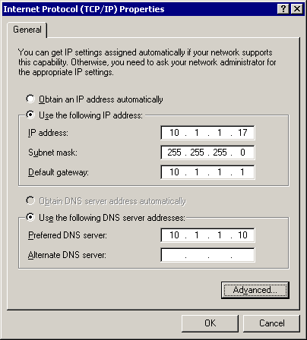
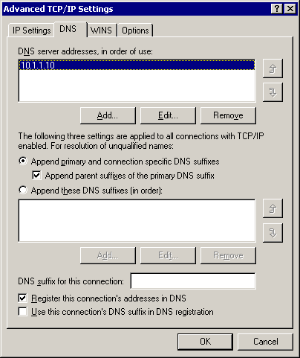
How Preferred and Alternate DNS Servers Work
3. Optionally, you can enter a whole list of alternate DNS servers
1. The preferred DNS server is the one that the client tries first
4. The preferred and alternate DNS servers specified on the Properties page automatically appear at the top of this list, and preferred and alternate servers are queried in the order they are listed
2. If the preferred server fails, the client tries the alternate DNS server

Slide 46
How Suffixes Are Applied
Suffix Selection
option
Domain suffix search list
Name query = server1
server1.sales.south.nwtraders.com
server1.south.nwtraders.com
server1.nwtraders.com
Connection Specific Suffix

Slide 47
How to Configure a DNS Client
Your instructor will demonstrate how to:
Manually configure a DNS client to use preferred and alternate DNS servers
Configure the DNS server option and the DNS suffix option in DHCP

Slide 48
Practice: Configuring a DNS Client
In this practice, you will configure a DNS client

Slide 49
Lesson: Delegating Authority for Zones
What Is Delegation of a DNS Zone?
How to Delegate a Subdomain to a DNS Zone

Slide 50
What Is Delegation of a DNS Zone?
Namespace: training.nwtraders.msft
The administrator, at the nwtraders.com level of the namespace, delegates authority for training.nwtraders.com and offloads administration of DNS for that part of the namespace
DNS server
training.nwtraders.msft
Training.nwtraders.com now has its own administrator and DNS server to resolve queries in that part of the namespace/organization
DNS server
training.nwtraders.msft
Delegation is the process of assigning authority over child domains in your DNS namespace to another entity by adding records in the DNS database

Slide 51
How to Delegate a Sub-domain to a DNS Zone
Your instructor will demonstrate how to delegate a sub-domain to a DNS zone

Slide 52

Lab A: Resolving Host Names by Using Domain Name System
In this lab, you will resolve host names by using DNS

